Slide 1





















SwarmGenomics Unmapped Reads
ATGCTTCGCGAACGTACGTCGCGAACATTATGCTTCGCGAACGTACGTACGTAGGT

Slide 2
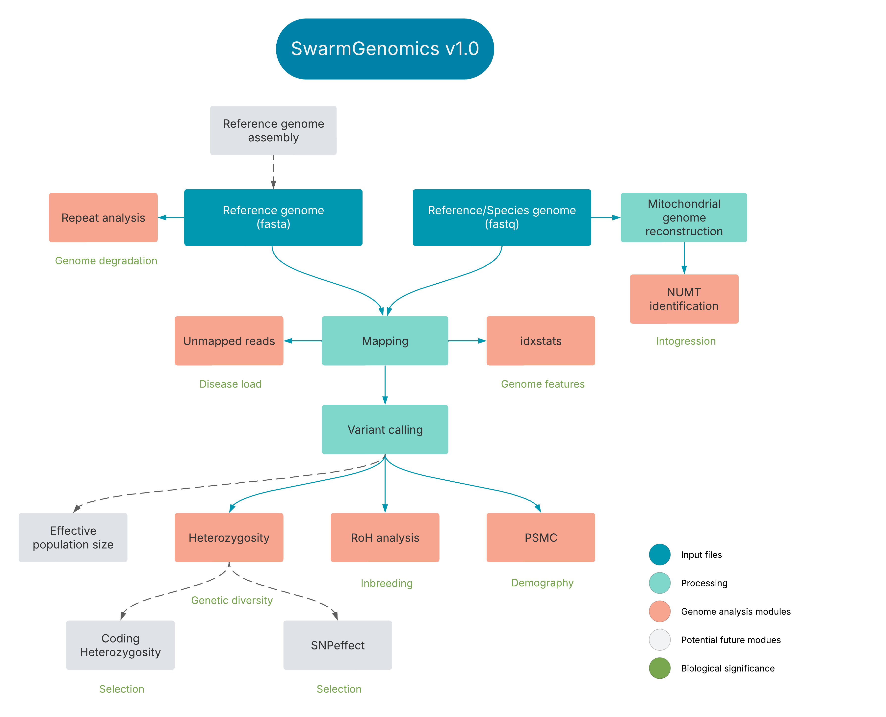

Slide 3
Background
Reads that fail to align to the provided reference genome
Often discarded or ignored in traditional workflows

Slide 4
Why interesting?
Biological Discovery
Hidden Microbial Sequences
Often come from bacteria, viruses, fungi, or other non-host organisms
Relevant in:
Tumor microbiome research
Infection diagnosis from RNA-seq or WGS samples
Host-pathogen interaction studies
Novel Genomic Elements
May come from previously unknown sequences, such as:
Structural variants
Insertions/deletions not in the reference genome
Transposons or endogenous retroviruses

Slide 5
Why interesting?
Biological Discovery
Environmental or Microbiome Data
In metagenomic or environmental samples, many reads don’t map because:
No suitable reference genome exists.
Organisms are poorly characterized or unknown.
Technical Quality Control
Contamination Detection
Pipeline and Reference Issues
Use of the wrong genome build
Problems in read preprocessing (adapter trimming, QC)
Misindexed references or sample mix-ups.

Slide 6
Why interesting?
Metrics of Data Quality and Sample Identity
Consistent unmapped read patterns across samples can:
Suggest batch effects or reagent contamination
Help confirm sample identity (e.g. microbiome signatures)
Indicate degradation or low-complexity sequences.

Slide 7
Causes
Cause of Unmapped Reads | Explanation
Contamination | DNA/RNA from other organisms (bacteria, viruses, lab contaminants, vectors).
Incomplete or incorrect reference | Host reference genome is missing regions (common in non-model organisms).
Novel sequences or insertions | Reads come from unknown or uncharacterized parts of the genome.
Poor read quality | Reads with too many sequencing errors are discarded during mapping.
Adapters or artifacts | Untrimmed adapters or poly-N stretches prevent proper alignment.
Highly repetitive regions | Multi-mapping reads can be discarded by aligners with strict settings.

Slide 8
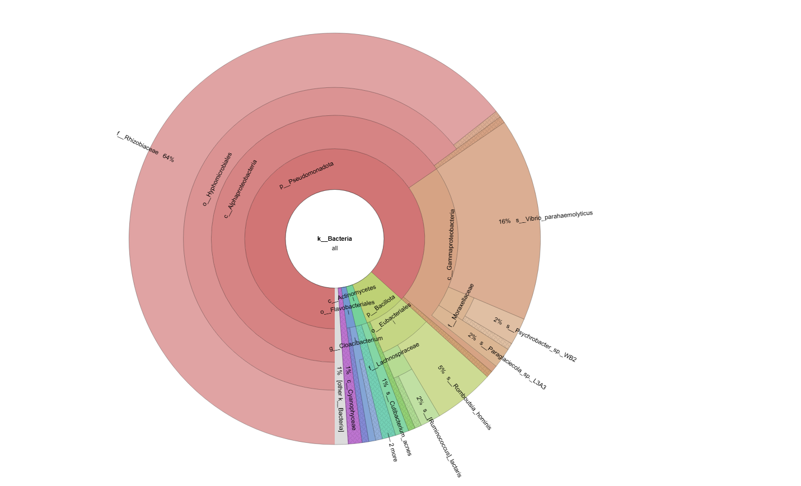
11. Unmapped Reads
https://github.com/AureKylmanen/Swarmgenomics/blob/main/11.%20Unmapped%20Reads.md

Slide 9
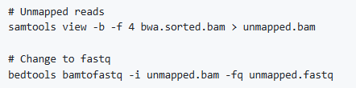
11. Unmapped Reads
Get unmapped reads from the BAM file and change them to fastq format

Slide 10
11. Unmapped Reads
Activate kraken environment

Slide 11
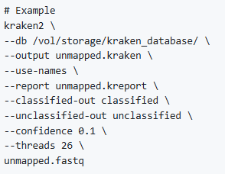
11. Unmapped Reads
Modify script according to your species
Path to the downloaded kraken database
Rename if needed
Change number of threads accordingly

Slide 12
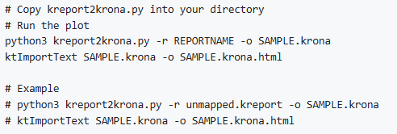
11. Unmapped Reads
Download and copy kreport2krona.py into your directory
Plot the results

Slide 13
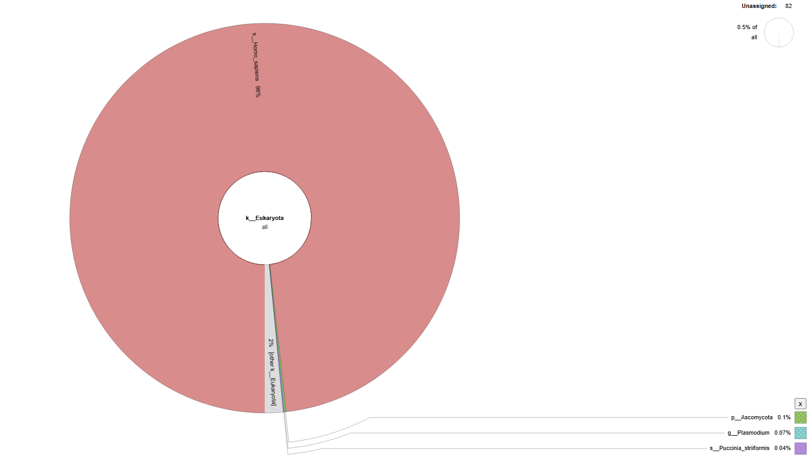
11. Unmapped Reads
The results are stored in an interactive .html file which you can open in a browser

